Slide 1
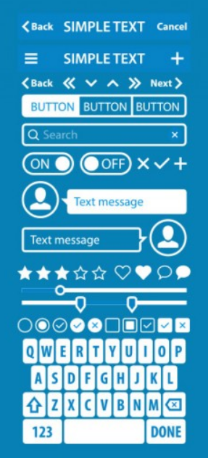
Capstone Project UX/UI Design

Slide 2
Objective
To design a event discovery application that enables users to perform following activities.
Search and locate events exclusively for kids aged between 4-14 years.
Suggest Events/workshops based on their interest.
Sign up for the events/workshop.
Organizers to advertise and promote events/workshops

Slide 3
5S Model
We have followed 5S Model to design Blossom – Event Locator application.
5S Model comprises of the following Steps
Strategy - In this Step , we understand our users come up with UCD, user personas and user journey map along with competing products and companies.
Scope - Defined the features and functionalities to be built in the application.
Structure – We have defined the interaction design(user flow) and Information architecture.
Skeleton – low fidelity and high fidelity wireframes and interactive prototypes are built in this step.
Surface – In this step we deal with the visual design and UI structure of the UI .

Slide 4
Persona

Slide 5
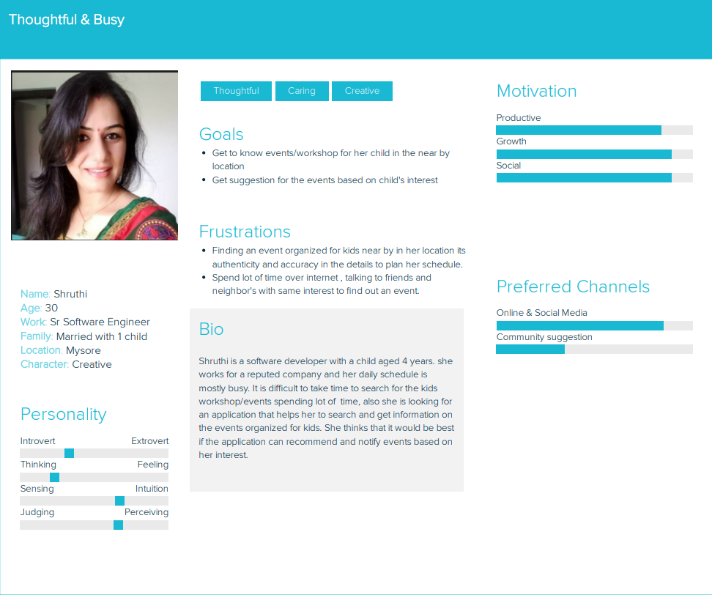

Slide 6
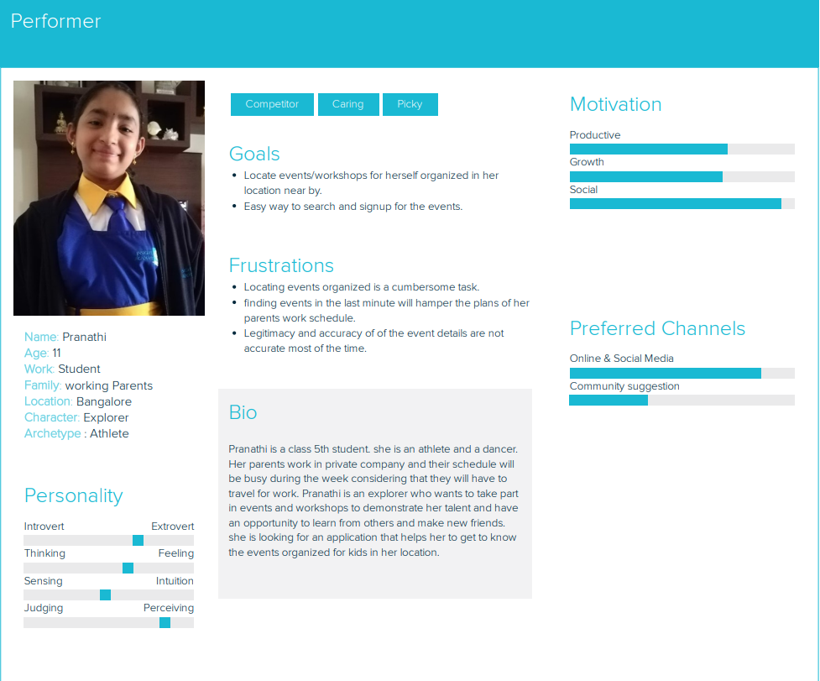

Slide 7
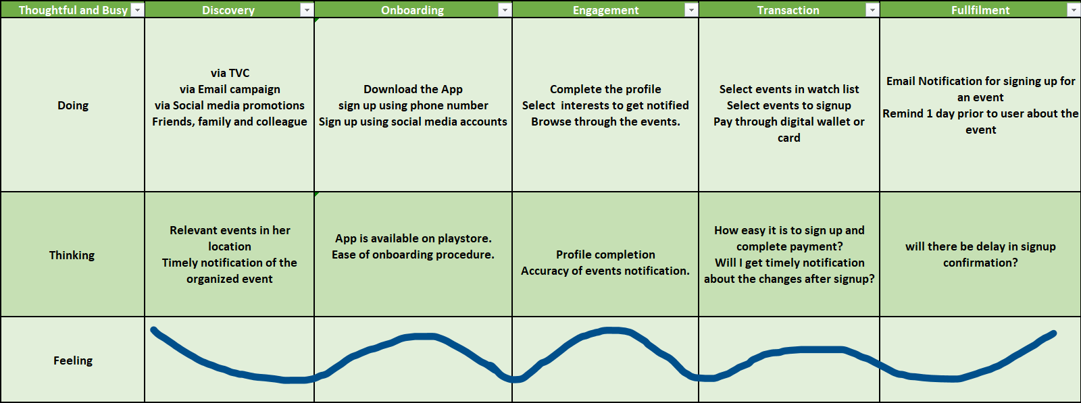

Slide 8
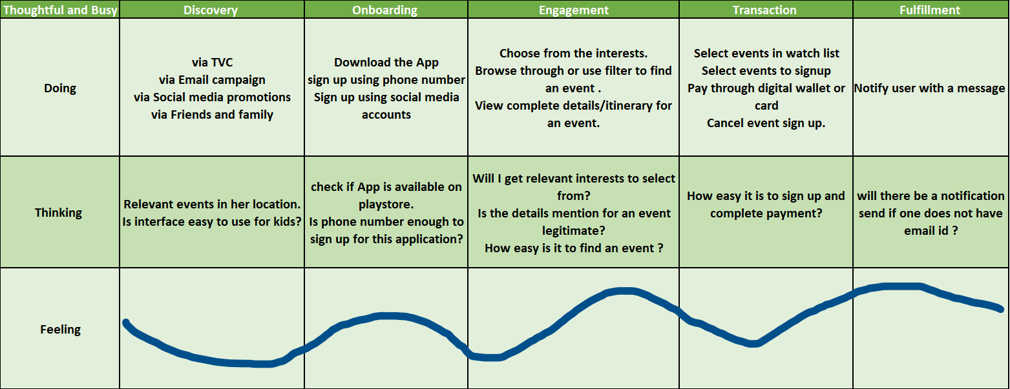

Slide 9
Digital Prototype
Click here to access digital prototype

